Slide 1
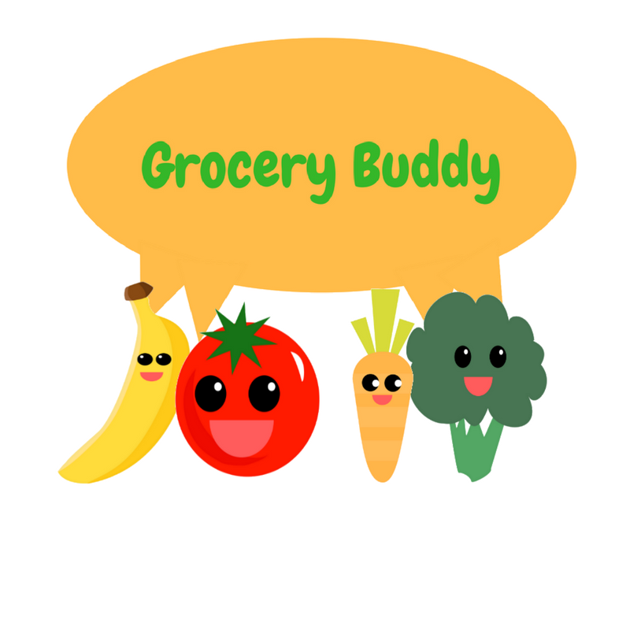
Grocery Buddy
By Ecoders (Patrick, Raly, Kevin, Toni, and Carlo)

Slide 2
Grocery Buddy
Group 25:
Its a grocery helper app that tracks not only what you buy at the store but also the contents of your fridge.
Notes:
“Make the most of out what you have”
Plan what you buy – Grocery Lists
Make sure you use it – Fridge expiry trackers and push notifications

Slide 3


What Does It Do?
“Make the most of out what you have”
Plan what you buy – Grocery Lists
Make sure you use it – Fridge expiry trackers and push notifications

Slide 4
What went well:
We learned a lot!
The UI turned out nicely!
The teamwork is excellent!
We got a lot of stuff done!
Excellent communication!

Slide 5
What didn’t go so well:
A lot of learning and fixing on the go!
Countless hours of fixing
Stress ☹
Caffeine consumption++

Slide 6
Workflow adjustments:
Planning
Smaller commits
Pull more frequently
Better task manager: Kanbanchi
Ask for help more often!
Try the pomodoro technique / half hour checkins.

Slide 7
App Showcase:
Add link here:

Slide 8
Weekly Challenge #1: App Affiliates
Add link:

Slide 9




Conclusion
THANKS!

